Slide 1
Superstore Sales Data Dashboard
Presented by:- Sanjana Jadhav
Date:- 14 July 2024

Slide 2
Introduction
Overview of the superstore sales data project
Objectives:- Analyze sales performance, identify rating and recommend improvements

Slide 3
Dataset Columns
Invoice Id
Branch
City
Customer Type
Gender
Product line
Unit Price
Quantity
Tax 5%
Total
Date
Time
Payment
COGS
Gross margin
Rating

Slide 4
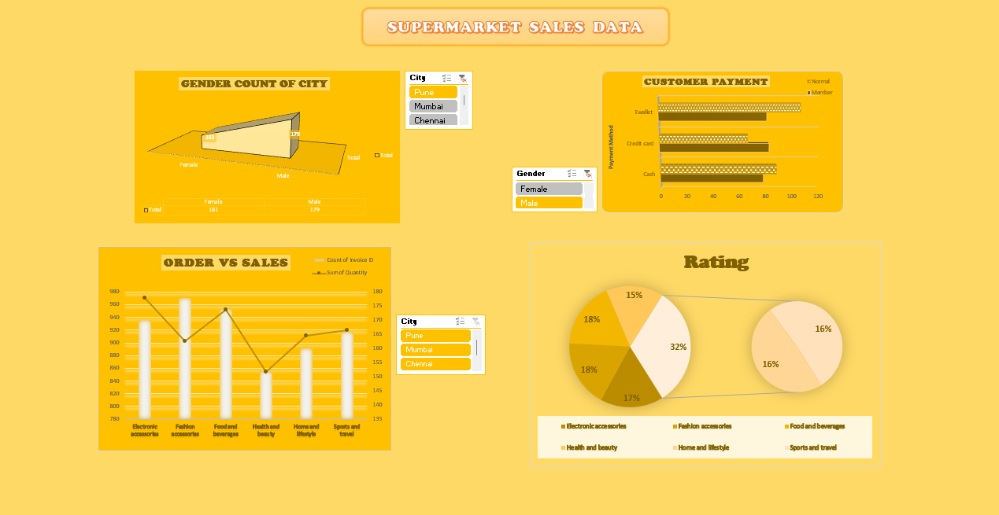
Dashboard Overview
Sections:- Gender Count of city, Customer Payment, Order VS Sales, Rating.

Slide 5
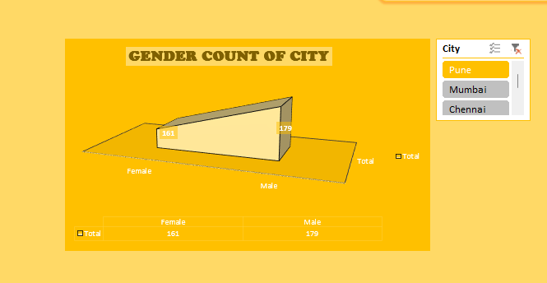
Gender Count Of City
- In this section we have calculated the gender count
of every city.
- I have added the slicer to check whether in which
which city male and female count of customer
There is also table in figure that shows total count
of both separate column

Slide 6
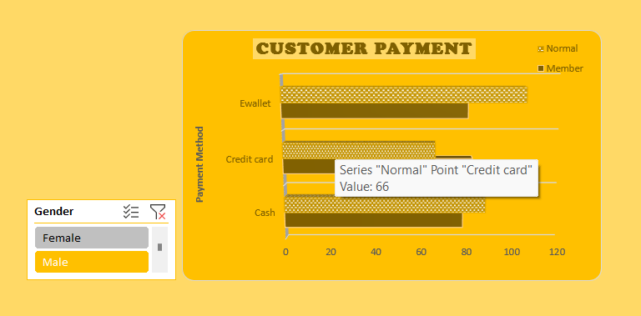
Customer Payment
In this slide various type of payment by customer is discover
Three type of payment:- Ewallet, Credit card, cash.
The payment is divide by member and normal customer in chart.
And slicer is added to check whether how many female and male separately payment method.

Slide 7
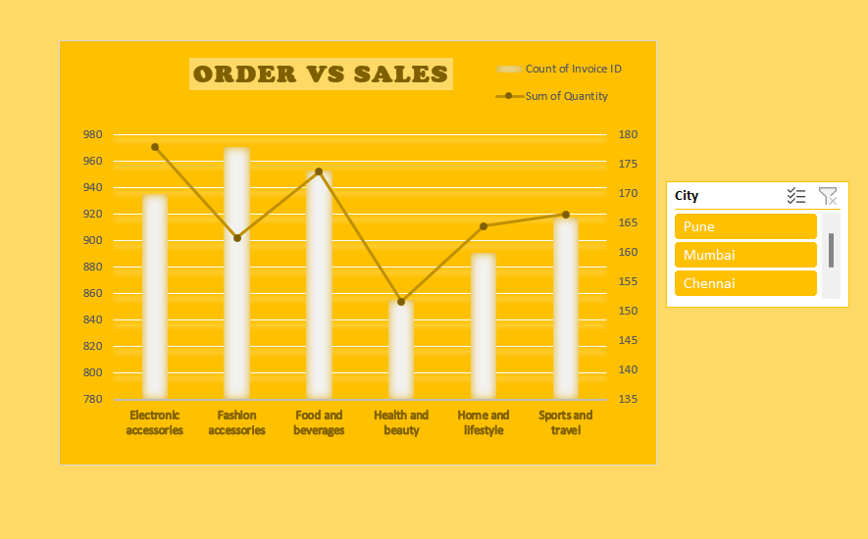
Order VS Sales
The slide discuss about the order of Products and sales count of that Product.
Various products are display:-
Electronic Accessories, Fashion Accessories, Food and Beverages, Health and Beauty, Home and Lifestyle, Sports and Travel.
Slicer to check sales of different cities.

Slide 8
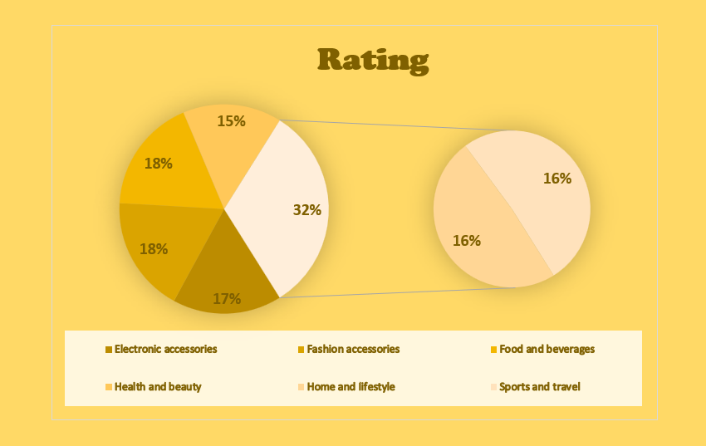
Rating
There is rating for each Product Appliances in this figure.
It shows which product is more Saled to customer or which is more required by seeing the percentage of rating.

Slide 9
Insights and Recommendations
focus on high performing product categories (Electronics, Furniture)
Expand marketing efforts in the Central region
Enhance customer engagement with corporate clients
Monitor sales and adjust inventory accordingly

